Slide 1
ASP.NET Core Workshop

Slide 2
Agenda
Session
Brief introduction to .NET Core and ASP.NET Core
Labs
Lab 1 - Introduction to .NET Core and ASP.NET Core
Lab 2 - Introduction to Routing and MVC 6
Lab 3 – Building Middleware
Lab 4 – Dependency Injection
Lab 5 – Logging and Diagnostics
Lab 6 – Razor Tag Helpers
Lab 7 – Hosting and Deployment

Slide 3
Labs / Slides
http://tinyurl.com/y8ta2n6h

Slide 4
ASP.NET Core What and Why
Ovais Mehboob & Vlatko Stojanovski

Slide 5
.NET Core and ASP.NET Core

Slide 6





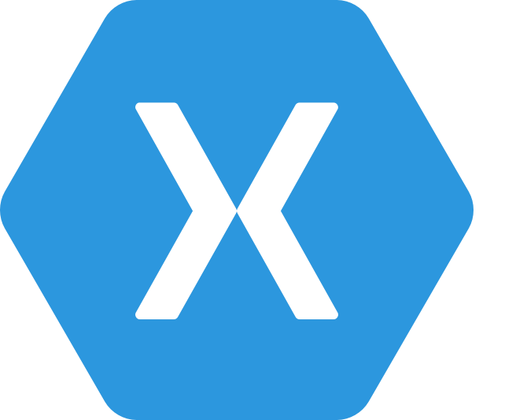
.NET Any developer, any app, any platform
iOS
OS X
Notes:
No better time to be a .NET developer – you have more scenarios at your finger tips than ever, using the technology you love and make you productive. You can literally build any app for any device for any platform with .NET.

Slide 7
Exciting times ahead for .NET
Multi-purpose, comprehensive framework for desktop and web applications
Modern DEVICE EXPERIENCE
Universal Windows platform
Unified development across Windows devices
XAMARIN
Extend your reach to any device with .NET
.NET FRAMEWORK
Modern CLOUD EXPERIENCE
.NET CORE
Cross-platform, high performance .NET
ASP.NET Core
Cloud optimized framework for micro services

Slide 8

History of .NET “verticals”
.NET
Windows Desktop
Windows Store
Windows Phone
ASP.NET 4
ASP.NET 5
App
Model
App
Model
App
Model
App
Model
App
Model
Framework
Framework
Framework
Runtime
Framework
Runtime
Runtime
Framework
Runtime
Runtime

Slide 9



.NET 5
.NET Framework 4.6
.NET Core 5
Common
Runtime
Compilers
NuGet packages
Next gen JIT
SIMD
.NET Compiler Platform
Languages innovation
.NET Core 5 Libraries
.NET Framework 4.6 Libraries

Slide 10
.NET Framework 4.6
.NET Framework 4.6
Highly compatible, in-place replacement for .NET 4, 4.5, 4.5.1, and 4.5.2
Full support of any .NET API and Libraries in the market
WPF is the platform of choice for desktop application development
ASP.NET 5 is also supported running on top of .NET 4.6
.NET 4.6 also gets the investment on new compilers, new Jit, and languages innovation
Evolution in time
.NET
Framework
4.5.2
.NET
Framework
4.5.1
.NET
Framework
4.5
.NET
Framework
4

Slide 11
.NET today—the family gets bigger
.NET FRAMEWORK
.NET CORE
XAMARIN
Platform for .NET applications on Windows
Cross-platform and open source framework optimized for modern app needs and developer workflows
Cross-platform and open source Mono-based runtime for iOS, OS X, and Android devices
Distributed with Windows
Distributed with app
Distributed with app
Notes:
Notes: Focus on the great additions to the .NET Framework, enabling developers to target the latest applications in the cloud and devices. Explain the distribution mechanism of each. .NET Framework is distributed and available on Windows whereas .NET Core & Xamarin are distributed with the app.

Slide 12
.NET today—app models and libraries
.NET FRAMEWORK
.NET CORE
XAMARIN
APP
MODELS
WPF
Windows Forms
UWP
iOS
Android
ASP.NET
ASP.NET Core
OS X
BASE
LIBRARIES
Base Class Library
Core Library
Mono Class Library
COMMON INFRASTRUCTURE
Compilers
Languages
Runtime components
Notes:
Notes: Even if we are reusing a lot across components (especially with the open sourcing last year), the reality is that each platform has its own implementation of the base libraries.
Note: .NET Framework BCL and Mono BCL are the same APIs, different implementation. .NET Core “Core Library” is a similar set of APIs, but different.

Slide 13
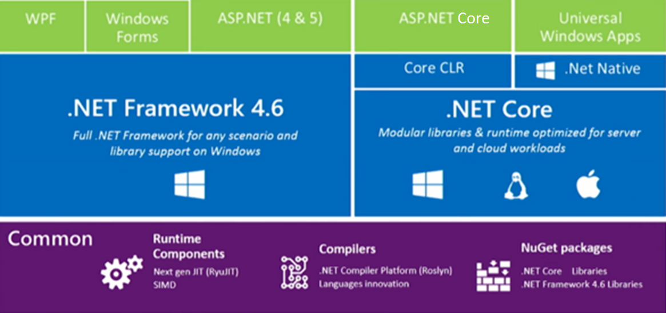
10k foot view

Slide 14
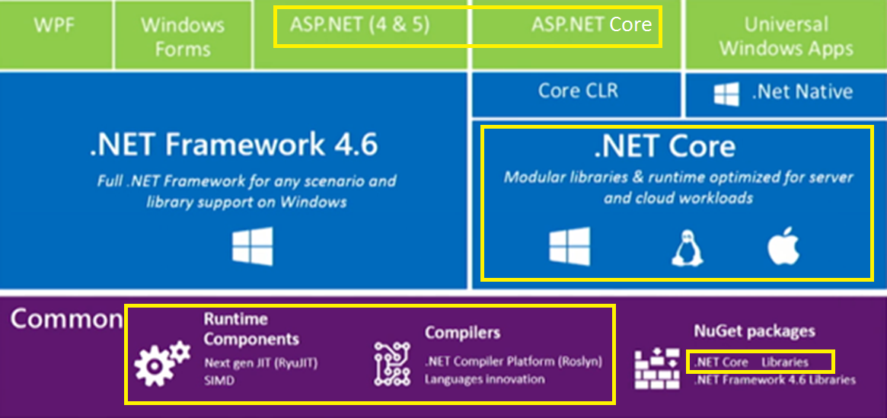
What is Microsoft Open Source

Slide 15
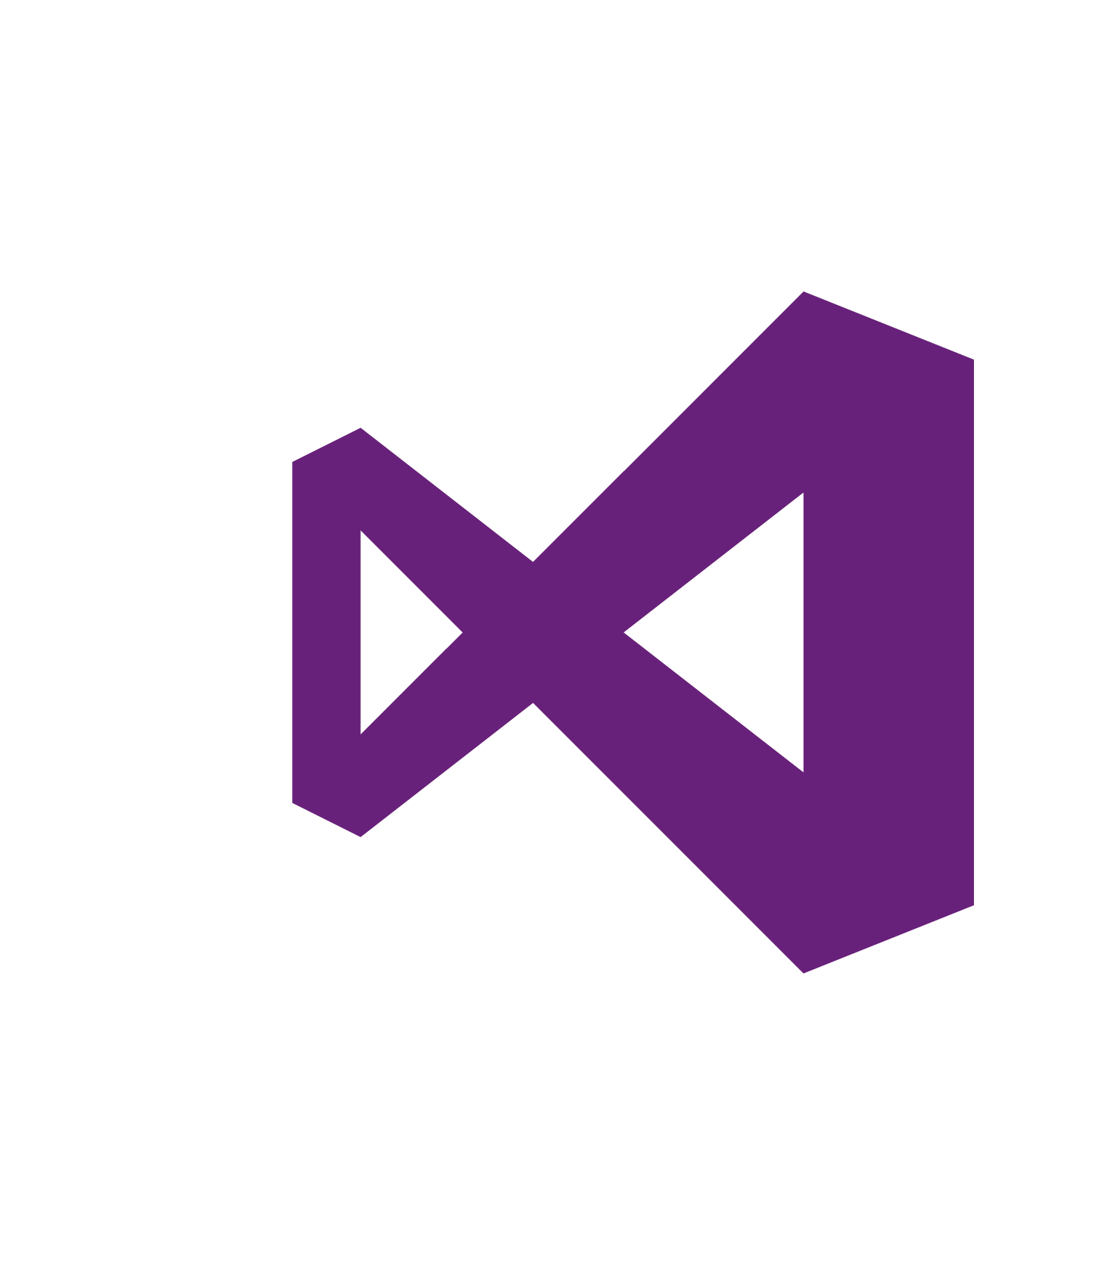


Tools for any developer and any app
Visual Studio for Windows & Mac
Visual Studio Code
Xamarin Studio
Command Line Interface
OPEN
Any App: Desktop, Mobile, Server, Cloud
Any Developer: IDE, Code editor, CLI
Any OS: Windows, OS X, Linux
POWERFUL
Easy and quick installation
Better productivity with reimagined inner loop
First-class .NET experiences
Notes:
In addition to a cross-platform .NET Core, we’re also providing tooling for any developer platform and workflow. Whether you develop with a PC or a Mac, we’ve got you covered with a wide range of tooling.

Slide 16
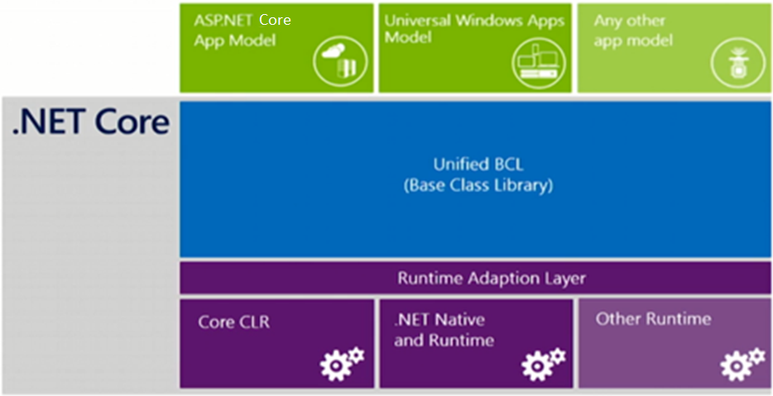
NuGet is mainstream in .NET Core

Slide 17
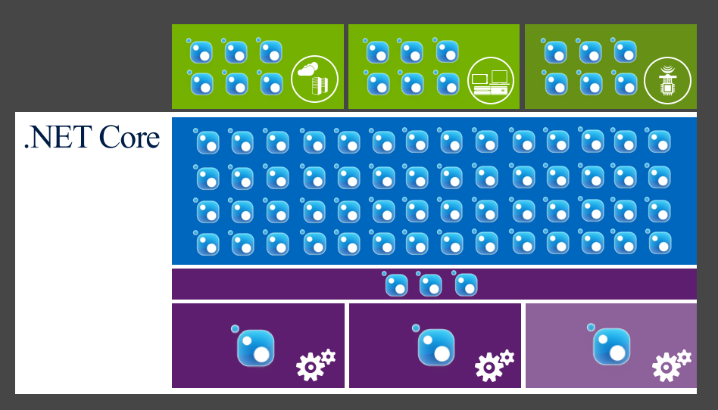
NuGet is mainstream in .NET Core

Slide 18
What is .NET Core
.NET framework to run cross platform
Composed of .NET Runtime (Core CLR), Framework Class Libraries (CoreFX) and SDK Tools (dotnet CLI)
Open source (MIT License) part of .NET Foundation
Out-of-the-box provide single app model –console apps

Slide 19
Benefits of .NET Core
Flexible Deployment (Self-contained or FDD)
Cross-Platform (Windows, Mac, Linux)
Command-Line tools (dotnet cli commands)
Compatible (.NET Standard)
Open source (.NET Foundation project)
Supported by Microsoft
Notes:
Flexible deployment – included in your app (self-contained) or

Slide 20
Languages supported
C#
F#
Visual Basic (not yet)
Notes:
Flexible deployment – included in your app (self-contained) or

Slide 21
App Models built on top of .NET Core
ASP.NET Core
Windows 10 UWP
Xamarin.Forms
Notes:
Flexible deployment – included in your app (self-contained) or

Slide 22
Download .NET Core
Comes with Visual Studio 2017
Separately installed by installing .NET Core SDK
Available as a NuGet package Microsoft.NetCore.App
https://www.nuget.org/packages/Microsoft.NETCore.App

Slide 23
.NET Compiler Platform (“Roslyn”)
Scenarios/usage cases
C#
VB
Language and IDE
FROM
Isolated/closed compilers
Hard to extend dev experience
API
VS dev experience extensibility
TO
API: open platform
Rich IDE experiences/refactoring
Code analysis
Custom diagnostics
Open Source compilers
OSS
Open Source

Slide 24
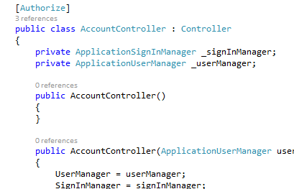
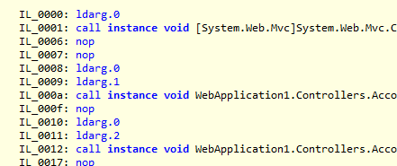

Code / Build / Debug
Deploy & Run
Roslyn takes your code and compiles it to IL. You have very modular references to the BCL and App Model you’re targeting.
References are built with your app into one native dll deployed locally with runtime
my.exe (stub)
my.dll
.NET Native tool chain
Code
(my.cs)
WinStore
.NET Native Runtime
Roslyn
IL
my.dll
+referenced dlls
ASP.NET
JIT Compiler
(RyuJIT)
+
+
CoreCLR
BCL
App Model
References & CoreCLR are deployed with app locally, JIT compilation on start up
References (Modular, NuGet)

Slide 25
Platform Portability
.NET FRAMEWORK
.NET CORE
XAMARIN
WPF
Windows Forms
UWP
iOS
Android
ASP.NET
ASP.NET Core
OS X
.NET STANDARD LIBRARY
One library to rule them all
COMMON INFRASTRUCTURE
Compilers
Languages
Runtime components
Notes:
Notes: Please welcome the .NET Standard Library [explain details]
As we move into the future we want to make it much easier for .NET developers to write their code once and be able to execute across .NET implementations, whether that’s .NET Framework, .NET Core, or Mono/Xamarin. To this end, we will continue to evolve and expand the .NET Standard into a set of APIs that are shared broadly across frameworks and application models. This will provide our ecosystem with much more explosive growth with libraries that can shared much more easily.

Slide 26
.NET Standard
Next generation PCL
Implemented by the Base Class Libraries for all .NET platforms
In some cases types are not fully implemented
Enables developers to produce portable libraries that are usable across different .NET platforms

Slide 27
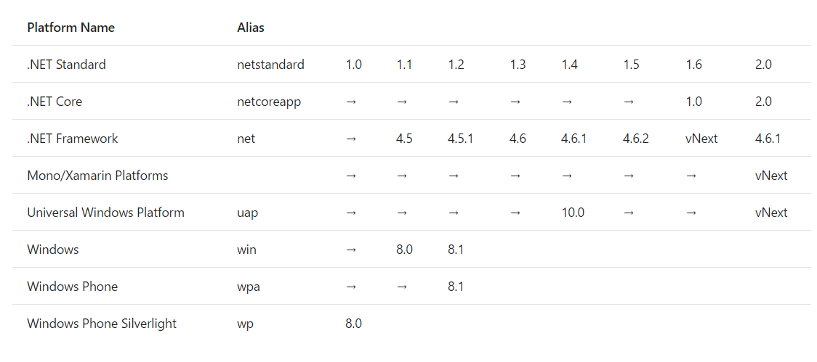
.NET Standard

Slide 28
Comparison to PCL
PCL | .NET Standard
PCL represents Microsoft Platforms | Agnostic to Platform
They are not linearly versioned | Linearly versioned
Defined by intersection of existing platforms | Represents curated set of APIs

Slide 29
.NET Standard—returning APIs
More API’s are back post .NET Core 1.0 (i.e. App Domains, Full Reflection, Binary Serialization)
.csproj.
Notes:
AppDomains, BFinary Serializer,

Slide 30
.NET CLI
Command Line Interface tooling
Build, run, restore and create projects using commands
Create custom templates

Slide 31
.NET Core Application Types
Portable
Self-contained

Slide 32
Portable
.NET Core is already present
Your .NET Core has a dll file that can be launched using dotnet utility
dotnet publish -f netcoreapp1.1 -c release

Slide 33
Self-Contained
.NET Core Libraries, .NET Core runtime included in your application and run side-by-side
SCDs include app.exe which is .NET Core host and application dll file that is the main assembly of your .NET Core application
dotnet publish -c release -r win10-x64
dotnet publish -c release -r osx.10.11-x64

Slide 34
How does ASP.NET fit in?

Slide 35
ASP.NET Core
Unified framework for MVC, Web API and SignalR
.NET Framework 4.6 stack and libs
.NET Core 5 stack and libs
Full .NET Framework for any scenario and library support
Small runtime optimized for server and cloud workloads

Slide 36
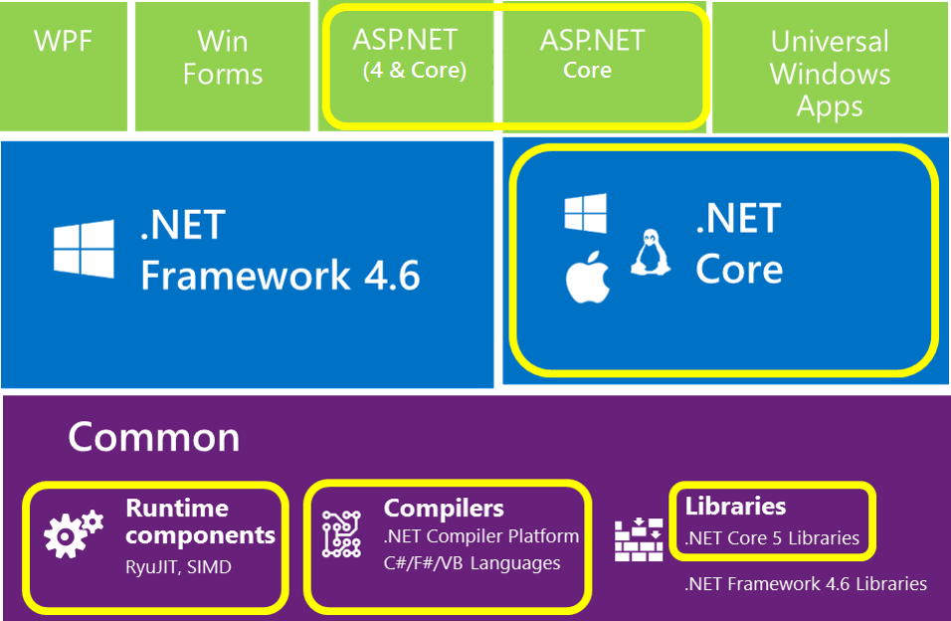
What is Open Source?

Slide 37
MSBuild -> csc.exe
CodeDOM -> csc.exe
Application
DNX (Roslyn)
Loose, GAC, NuGet
Libraries
NuGet
Open Source
FCL, GAC, NuGet
Application Frameworks
NuGet
IIS
Web Server
IIS, HTTP.SYS
Kestrel
System.Web
Application Host
DNX
.NET BCL & FCL
Platform Libraries
.NET BCL & FCL
.NET on NuGet
.NET CLR
Runtime
.NET CLR
.NET Core CLR
IIS: WebEngine4.dll
Exe: OS
Runtime Loader
DNX
Windows
Operating System
Windows, OSX, Linux

Slide 38
History of ASP (18+ years)
1996 – Active Server Pages (ASP)
2002 – ASP.NET
2008 – ASP.NET MVC
2010 – ASP.NET Web Pages
2012 – ASP.NET Web API, SignalR
2014 – ASP.NET Core (and the Core CLR)

Slide 39


ASP.NET and the Modern Web
Totally Modular
Faster Development Cycle
Seamless transition from on-premises to cloud
Choose your Editors
and Tools
Open Source with Contributions
OSS
Cross-Platform
Fast

Slide 40
Modern Web - Agility
Faster Development Cycle
Features are shipped as packages
Framework ships as part of the application
More Control
Zero day security bugs patched by Microsoft
Same code runs in development and production
Developer opts into new versions, allowing breaking changes

Slide 41
Modern Web - Fast
Runtime Performance
Faster startup times
Lower memory / higher density (> 90% reduction)
Modular, opt into just features needed
Use a raw socket, framework or both
Development productivity and low friction
Edit code and refresh browser
Flexibility of dynamic environment with the power of .NET
Develop with Visual Studio, third party and cloud editors

Slide 42
Modern Web - Cloud
Seamless transition from on-premises to cloud
Cloud ready
Configuration
Session
Cache
Diagnostics
Run/Debug in Cloud
Tracing/Logging without re-deploy

Slide 43
Modern Web – Cross Platform
Runtime
Windows, Mac, Linux
Editors
Visual Studio, Text, Cloud editors
No editors (command line)
OSS
Open Source with Contributions

Slide 44
ASP.NET 2015 in a Nutshell
Visual Basic 14
Visual Basic 14 (coming soon)
C#
Web
Forms
MVC 5.x
Web API 2.2
MVC / Web API 6
ASP.NET 4.6 System.Web
ASP.NET Core
Core CLR
.Net Native
.NET Framework 4.6
.NET Core
Full .NET Framework for any scenario and
library support on Windows
Modular libraries & runtime optimized for server and cloud workloads

Slide 45
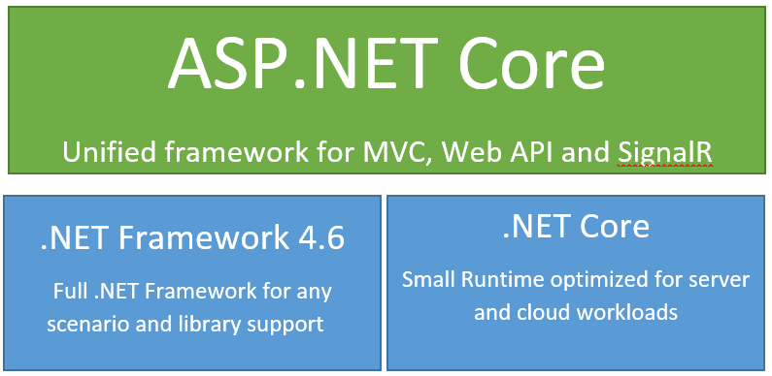

Slide 46
ASP.NET Core - Compatibility
Web Forms, MVC 5, Web API 2, Web Pages 3, EF 6
Fully supported on .NET 4.6
MVC, Web API, EF 7
Breaking changes:
New Project System
New Configuration System
MVC / Web API / Web Pages merge
No System.Web, new Lightweight HttpContext (not System.Web)
.NET 5 on Core CLR
Subset of the .NET Full Framework
Things you depend on might not be available yet

Slide 47
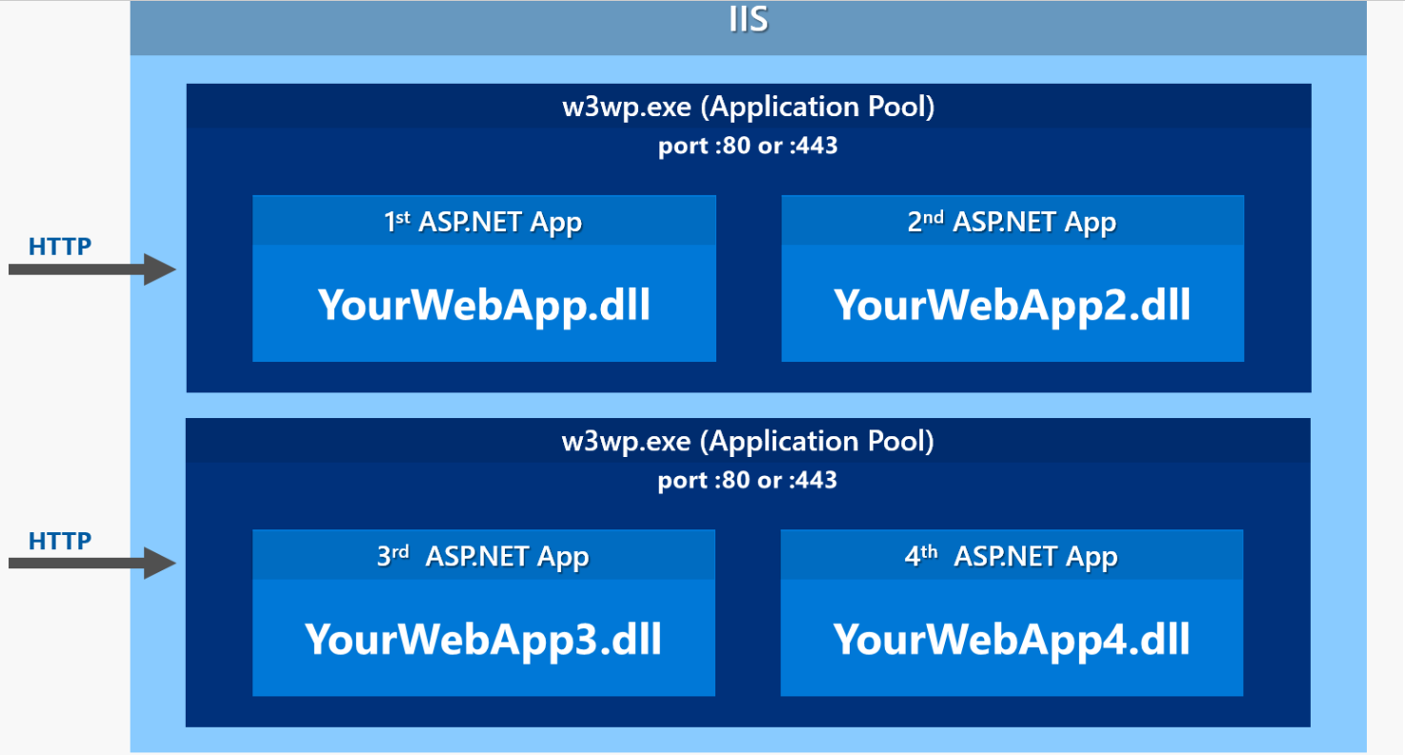
How ASP.NET Process Request in previous versions
Notes:
In a classic ASP.NET application everything is hosted inside of an IIS Worker Process (w3wp.exe) which is the IIS Application Pool. The AppPool hosts your ASP.NET application and your application is instantiated by the built-in ASP.NET hosting features in IIS. The native runtime manager instantiates the .NET Runtime on your application's behalf and brings up the HttpRuntime object which is then used to fire requests through the ASP.NET application pipeline as requests come in from the native http.sys driver. Requests come in from http.sys and are dispatched to the appropriate site that is mapped to the Application Pool and the HttpRuntime instance hosted there.

Slide 48
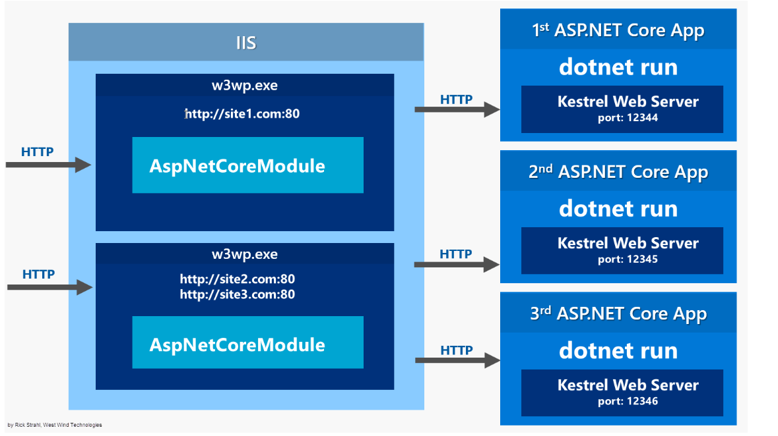
New Processing Model with IIS
Notes:
Things are quite different with ASP.NET Core which doesn't run in-process to the IIS worker process, but rather runs as a separate, out of process Console application that runs its own Web server using the Kestrel component. Kestrel is a .NET Web Server implementation that has been heavily optimized for throughput performance. It's fast and functional in getting network requests into your application, but it's 'just' a raw Web server. It does not include Web management services as a full featured server like IIS does.
If you run on Windows you will likely want to run Kestrel behind IIS to gain infrastructure features like port 80/443 forwarding via Host Headers, process lifetime management and certificate management to name a few.
Here's what it looks like when you run your ASP.NET Core application behind an IIS Web front:

Slide 49
Hosting Servers
ASP.NET Core is completely decoupled from web server environment that host the application
Supports hosting in IIS, IIS Express, and self hosting using Kestrel and WebListener HTTP Servers
Developers and third party can develop their own servers

Slide 50
Self Hosted Servers
Ships with two different servers
Kestrel (Microsoft.AspNetCore.Server.Kestrel)
WebListener (Microsoft.AspNetCore.Server.WebListener)
Kestrel – cross platform
WebListener – windows only HTTP server run directly on Http.sys kernel driver

Slide 51
WebHostBuilder
Main entry that hooks up Startup
Defines Servers
URLs Kestrel running on (default is http://localhost:5000)
Many more methods

Slide 52
Services Available in Startup
IApplicationBuilder
Used to build the application request pipeline.
IHostingEnvironment
Provides the current EnvironmentName, ContentRootPath, WebRootPath in startup
ILoggerFactory
Provides a mechanism to create loggers
IServiceCollection
Holds the current set of services configured in the container.

Slide 53
Routing and MVC 6

Slide 54
MVC 6
Routing
Controllers
Model Binding
Razor

Slide 55
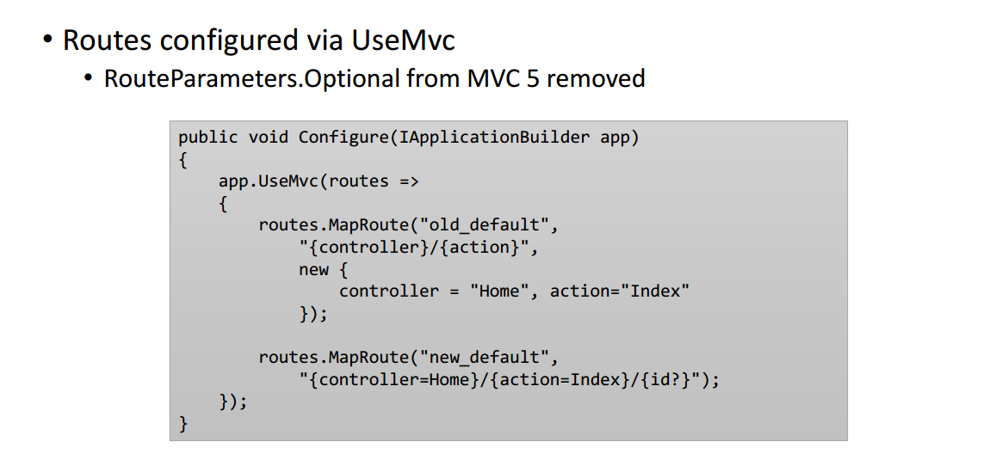
Routing

Slide 56
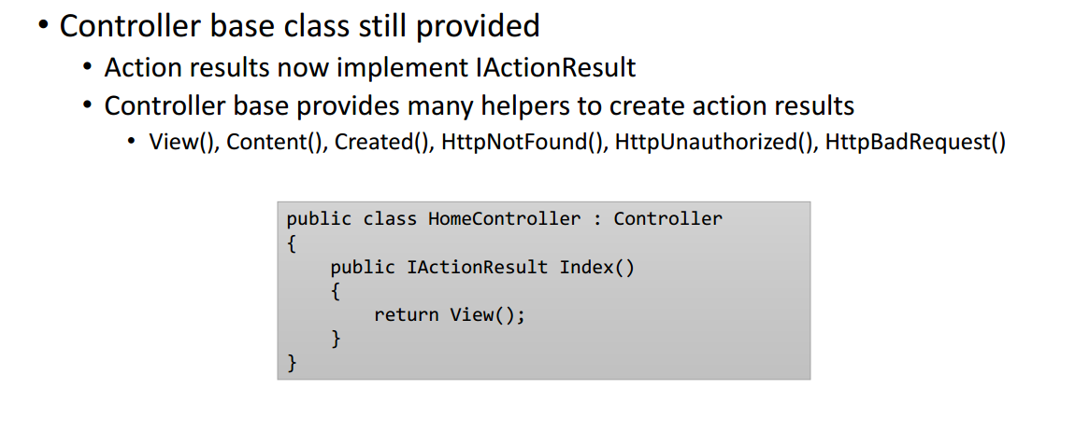
Attribute Routing

Slide 57
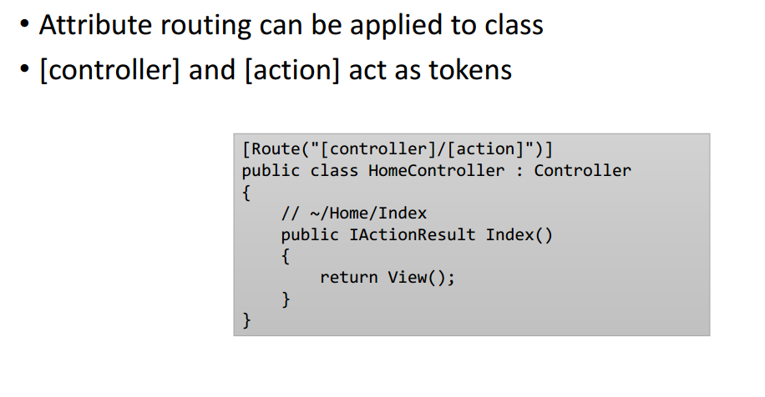
Attribute Routing

Slide 58
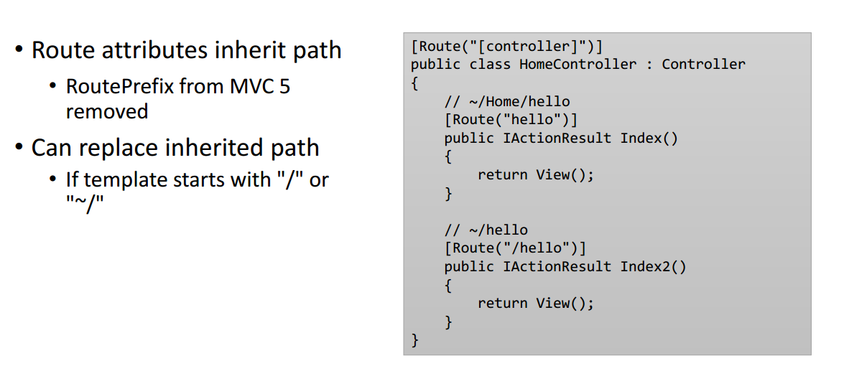
Combining Routing Parameters

Slide 59
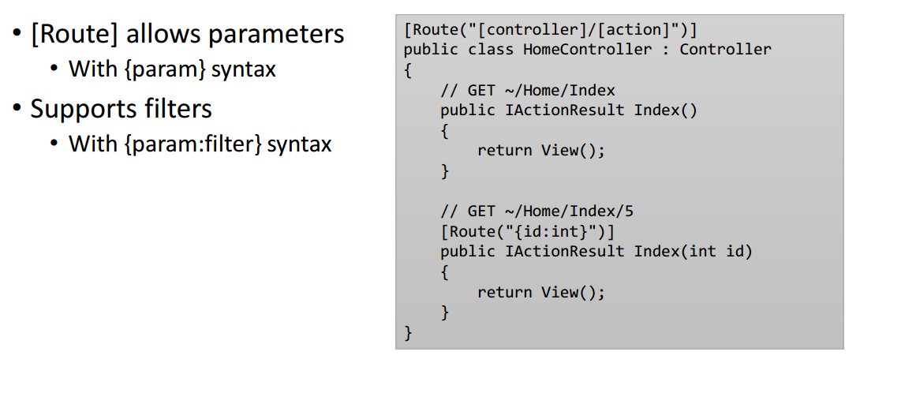
Route Parameters

Slide 60
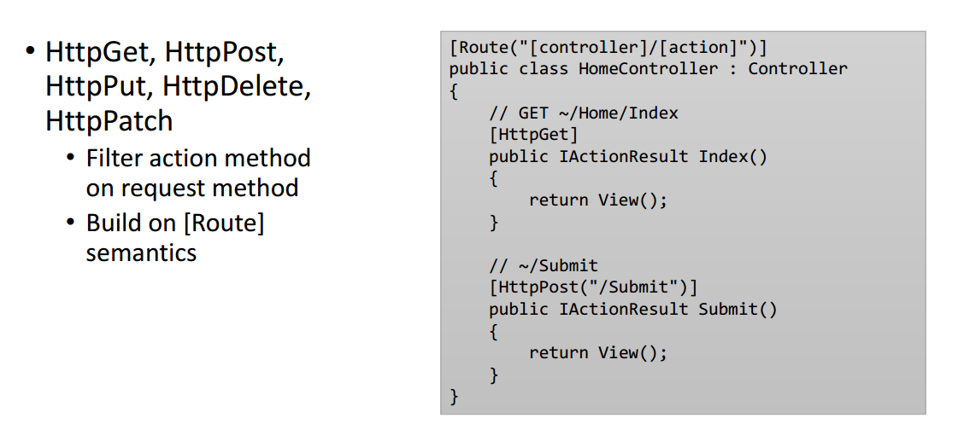
HTTP Based Routes

Slide 61
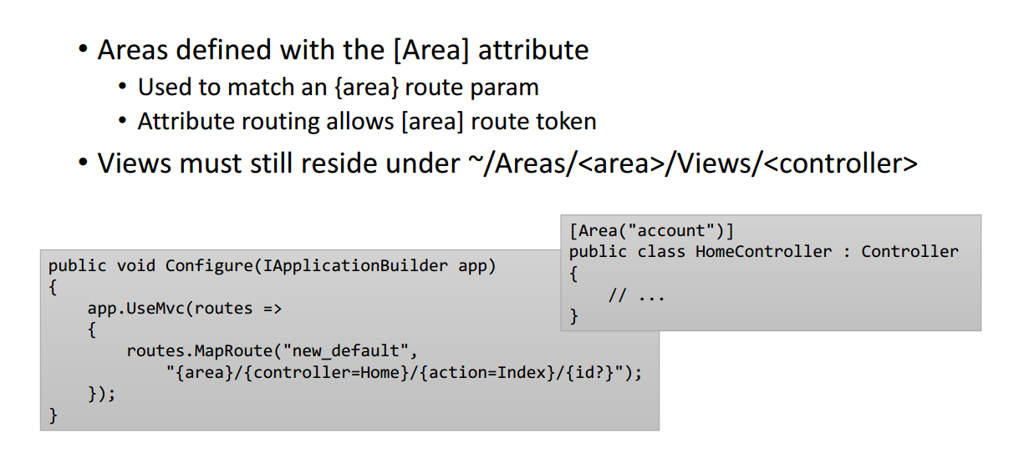
Areas

Slide 62
Controllers

Slide 63
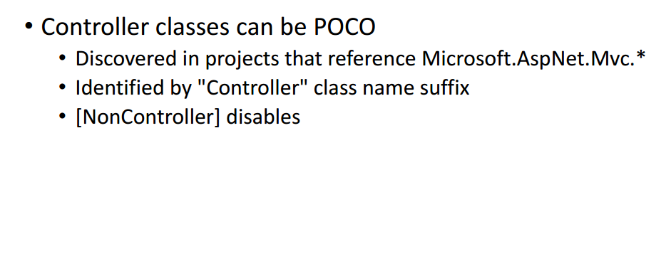
POCO Controllers

Slide 64
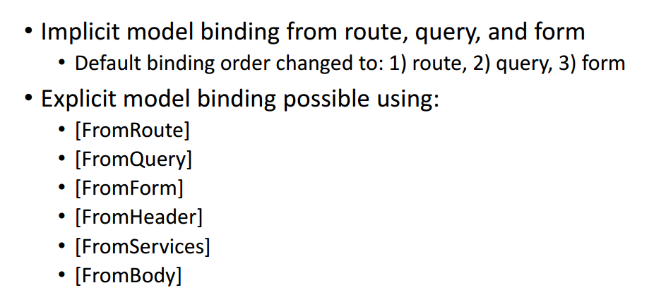
Model Binding Changes

Slide 65
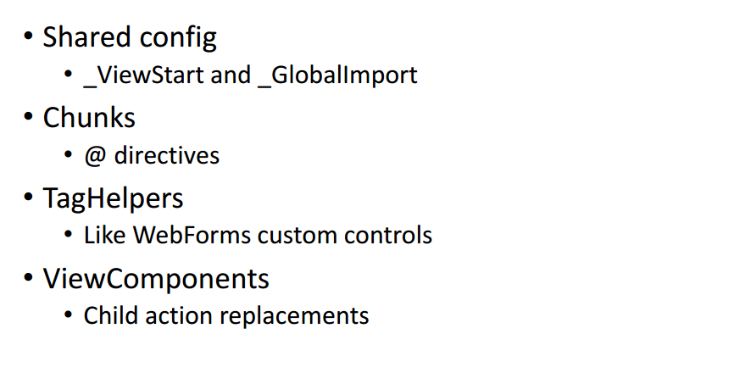
Razor

Slide 66
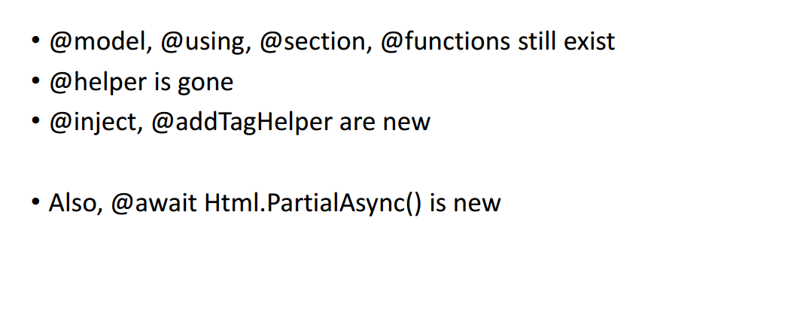
Razor Directives

Slide 67
Building Middleware

Slide 68
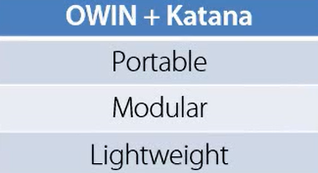
Katana – OWIN Implementation by Microsoft
Microsoft’s OWIN Implementation
http://katanaproject.codeplex.com
Set of hosts and servers
IIS / Self-host/ OWIN host
Set of classes
OwinContext, OwinRequest, OwinResponse, etc.
AppBuilderUseExtensions
Set of middleware
Authentication
Hosting Content (static files), etc.

Slide 69
What is OWIN
Started by group of Open source developers in the community to define the specification of how web server and web application can interact
The goal of OWIN is to decouple server and application and by being and open standard, stimulate the open source ecosystem of .NET web development tools

Slide 70
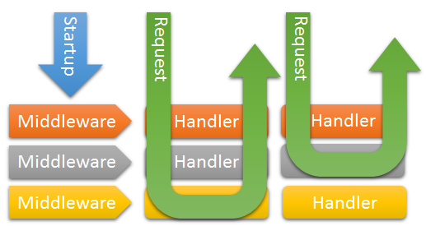
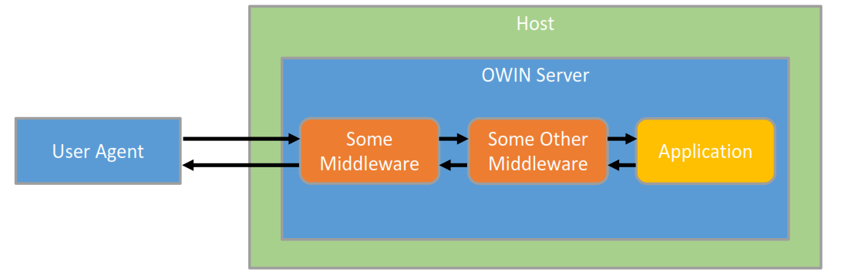
How OWIN/Katana works?
OWIN Server loaded all the middlewares specified in the pipeline
When request arrives, split request into Environment Dictionary
Call Invoke conventionally and pass dictionary
Each middleware can then Invoke the next middleware if needed

Slide 71
OWIN Classification
Application- Web Application
Middleware- Component linked together to make a pipeline
Server- Listen for HTTP request
Host – spins up the process
Application
ASP.NET MVC, Web API
Middleware (OwinIdentity, StaticFile, CustomMiddlewares,etc.)
Server SystemWeb, HttpListener
Host (IIS, OwinHost.exe, Custom Process)

Slide 72
OWIN Specification
Key Name | Value Description
"owin.RequestBody" | A Stream with the request body, if any. Stream.Null MAY be used as a placeholder if there is no request body. See Request Body.
"owin.RequestHeaders" | An IDictionary<string, string[]> of request headers. See Headers.
"owin.RequestMethod" | A string containing the HTTP request method of the request (e.g., "GET", "POST").
"owin.RequestPath" | A string containing the request path. The path MUST be relative to the "root" of the application delegate; see Paths.
"owin.RequestPathBase" | A string containing the portion of the request path corresponding to the "root" of the application delegate; see Paths.
"owin.RequestProtocol" | A string containing the protocol name and version (e.g. "HTTP/1.0" or "HTTP/1.1").
"owin.RequestQueryString" | A string containing the query string component of the HTTP request URI, without the leading “?” (e.g., "foo=bar&baz=quux"). The value may be an empty string.
"owin.RequestScheme" | A string containing the URI scheme used for the request (e.g., "http", "https"); see URI Scheme.
Environment models HTTP request/response
HttpContext
All .NET primitive types so no framework dependencies
Standard set of Key/Value pairs

Slide 73
Helios
Another OWIN implementation by Microsoft
Developed in 2013
To deploy ASP.Net Web application on top of IIS without using standard ASP.NET HTTP Pipeline
Add through NuGet
Microsoft.OWIN.Host.IIS
Runs with .NET Framework 4.5.1
When request comes to IIS, check if this assembly is loaded
Route the request to the Application pipeline (OWIN based) rather than going through the default Integrated pipeline

Slide 74
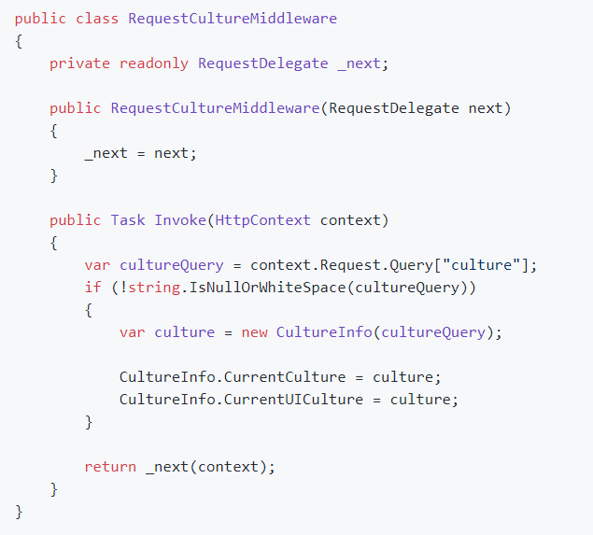
OWIN Middleware
Custom HTTP pipeline component
Implements Invoke method (Conventionally) that takes IDictionary<string,object> as parameter and returns Task as return type.

Slide 75
Dependency Injection

Slide 76
Dependency Injection
Lifestyle | Description
Instance | A specific instance is given all the time. You are responsible for its initial creation
Transient | A new instance is created every time
Singleton | A single instance is created and it acts like a singleton
Scoped | A single instance is created inside the current scope. It is equivalent to Singleton in the current scope

Slide 77
Dependency Injection
Old Stack
Create custom Controller Factory that derives from DefaultControllerFactory class
Override create controller method and specify your own logic to inject instances
Then, finally set the controller factory instance by calling SetControllerFactory of current controllerbuilder.

Slide 78
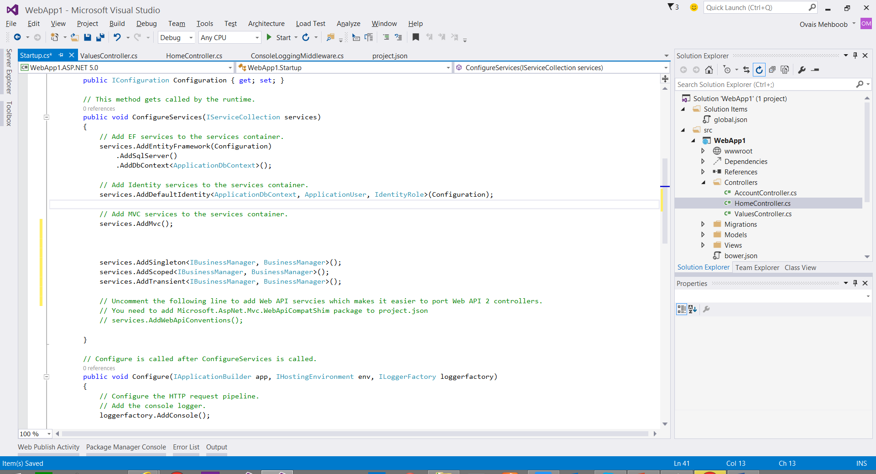
Dependency Injection
New Stack
All built in
Just call services.addScoped, addTransient, addSingleton etc and specify the interface and its implementation

Slide 79
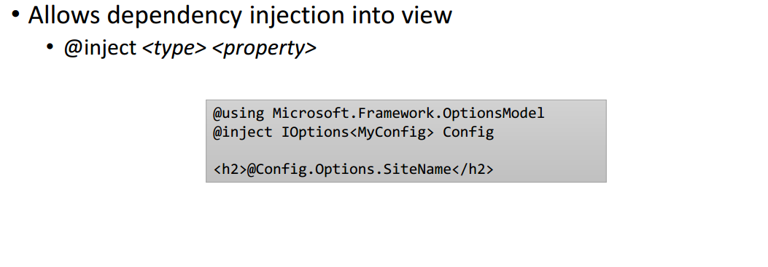
@inject

Slide 80
Logging and Diagnostics

Slide 81
Logging and Error Handling
Built in support for logging
Allows to leverage preferred logging framework as well
Requires minimal amount of time to configure

Slide 82
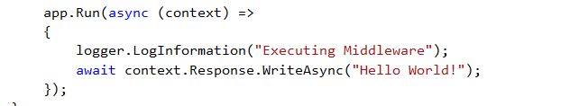
Implementing Logging
Request ILoggerFactory or ILogger<T> via DI
If ILoggerFactory is requested, Logger should be created using CreateLogger

Slide 83
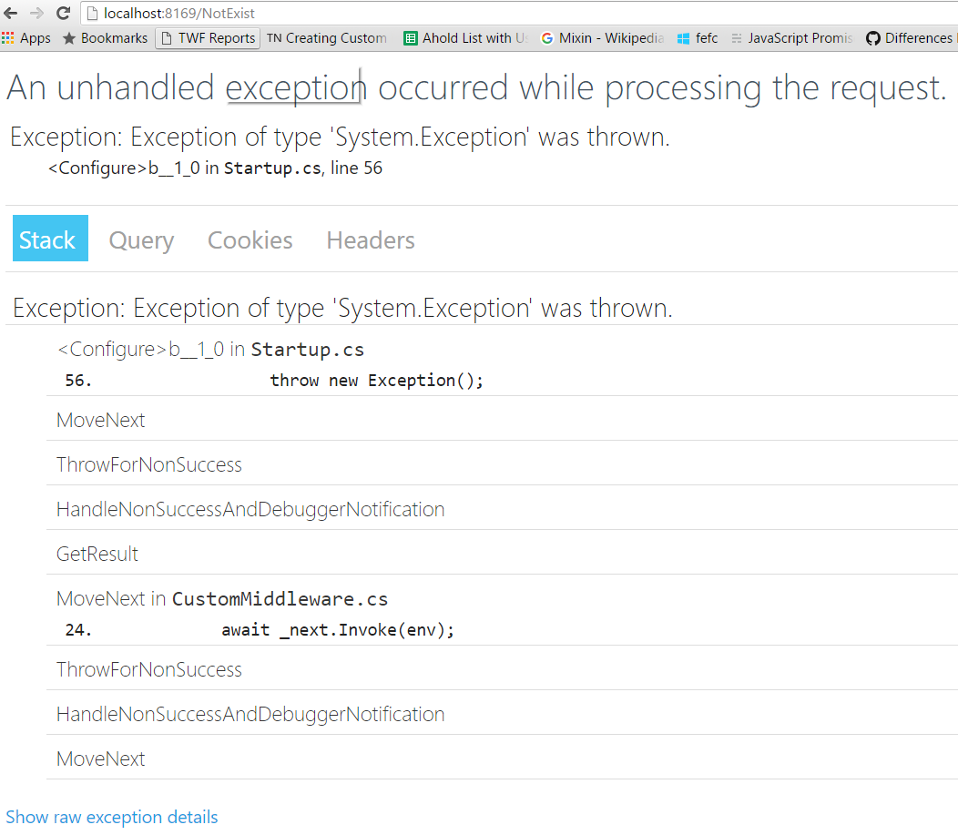
Error Handling
Use UseDeveloperExceptionPage() method to display developer exception page

Slide 84

Status Code Pages
Out of the box, does not provide status code page for HTTP status codes
Works for Status codes between 400 – 599
Add middleware StatusCodePages middleware in Configure() method

Slide 85
StatusCodePages extension methods
//To return response on the status codes between 400 - 599
app.UseStatusCodePages("text/plain", "{0}");
//To redirect request to specific Error page
app.UseStatusCodePagesWithRedirects("/{0}.html");
//To re-execute request
app.UseStatusCodePagesWithReExecute("/StatusCode/{0}");
- Keep the same status code

Slide 86
Tag Helpers

Slide 87
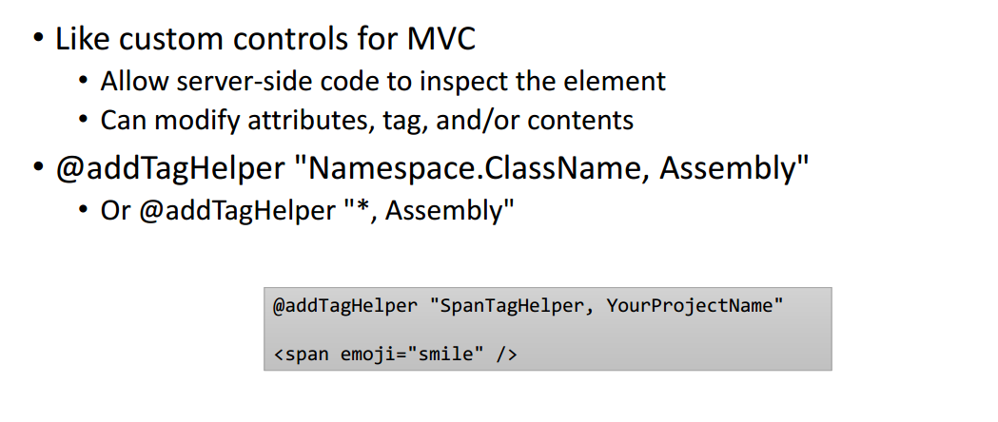
Tag Helpers

Slide 88
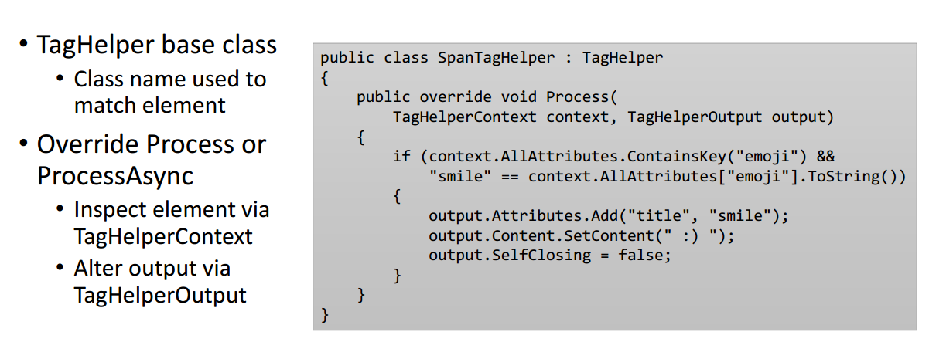
Tag Helpers

Slide 89
Tag Helper Implementation

Slide 90
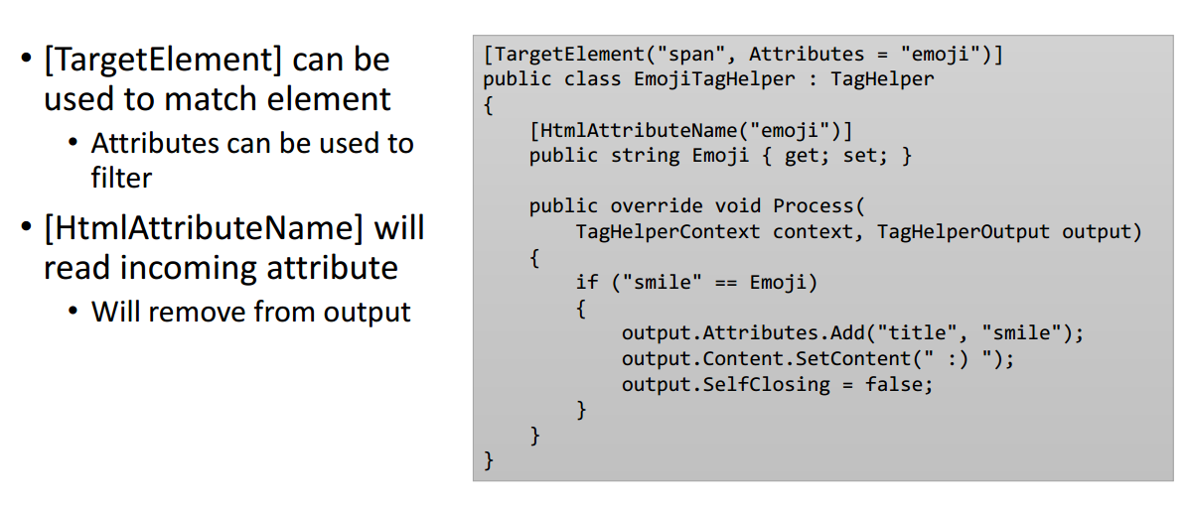
Tag Helper Implementation

Slide 91
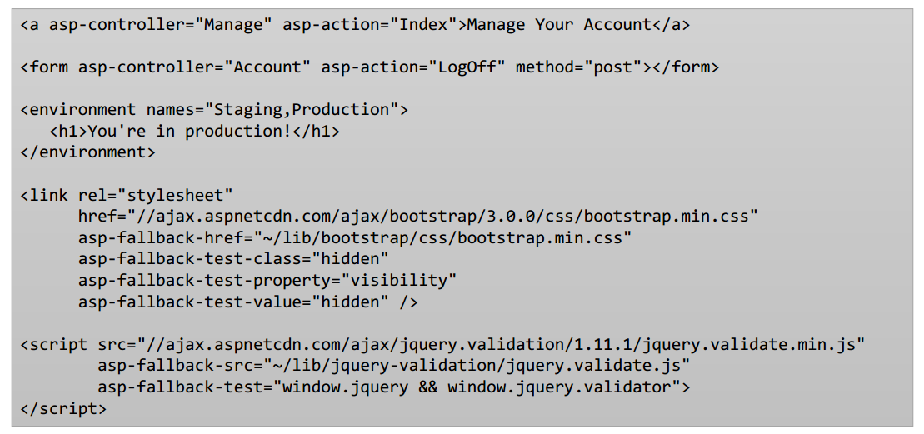
MVC Tag Helpers

Slide 92
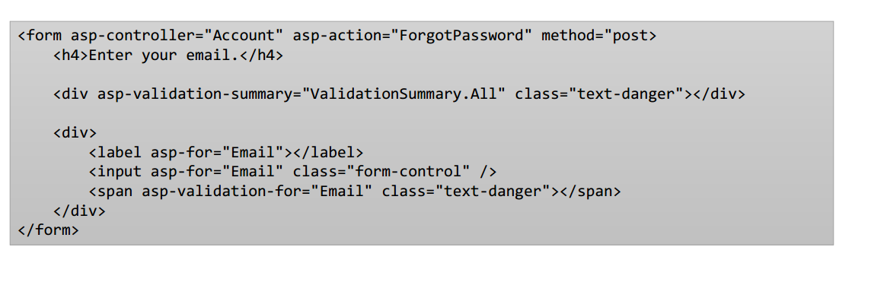
Validation Tag Helpers

Slide 93
Hosting and Deployment

Slide 94
ASP.NET Core Publishing
3 easy steps
Restore package dependencies
Publish your application
Deploy on production

Slide 95
ASP.NET 4 Publishing process
ASP.NET 4 publishing process executes as MSBuild task
You invoke the build and MS Build calls the publish process
To Customize publishing process, need to understand all the MSBuild tasks, targets, properties and customization is complex!!

Slide 96
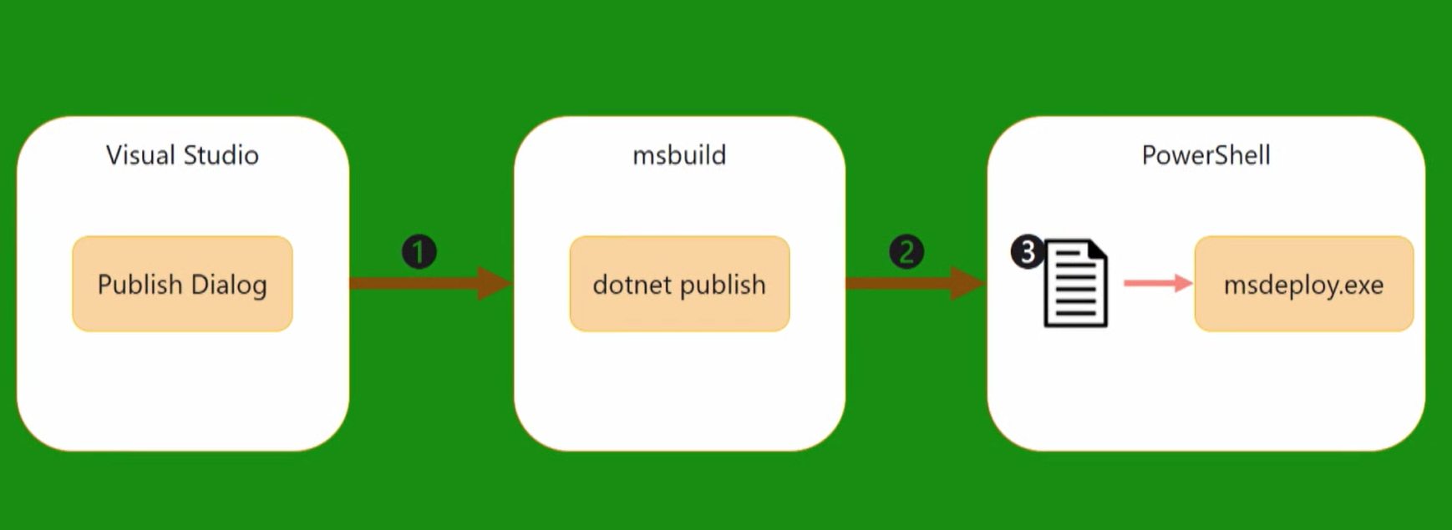
Publishing in ASP.NET Core
More simpler process model
Notes:
Talk about Publish dialog. Right now we have few options but MSFT is working on to provide SFTP, MSDeploy commands, Publish at Linux box (some technology top of ssh)

Slide 97
ASP.NET Core Module- for IIS and IIS Express
ASP.NET Core is native IIS module used to proxy requests to external processes that it manages
On Windows, the ASP.NET web application is hosted by an external process outside of IIS.

Slide 98
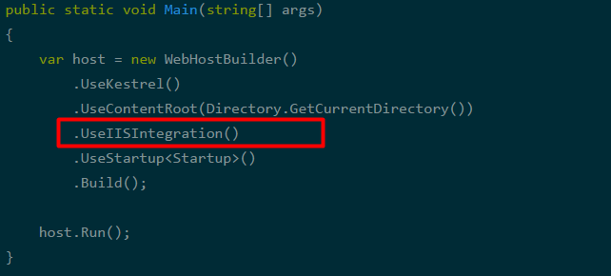
Publishing to IIS
Enabling the IISIntegration components

Slide 99
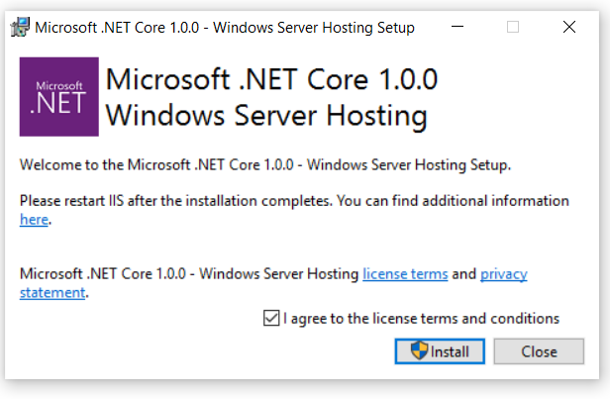
Installing ASP.NET Core Module
Install Microsoft .NET Core 1.0.0 Windows Server Hosting
This module creates reverse proxy between IIS and Kestrel server

Slide 100
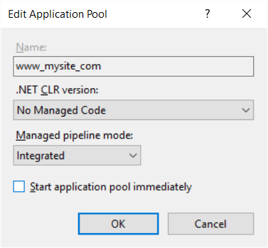
App Pool settings

Slide 101
ASP.NET Core - Summary
MVC 6 (MVC + Web API + Web Pages)
Feature | Running on .NET 4.6 | Running on .NET Core 5
Cloud Ready | * | *
Modular Design | * | *
Dependency Injection | * | *
Consistent Tracing / Debugging | * | *
Faster Development (No Build Step) | * | *
Open Source | * | *
Full Side by Side (framework deployed inside application) |  | *
Fast startup, Low memory / High throughput (best of class) |  | *

Slide 102
ASP.NET Core resources
Get started at http://www.asp.net
GitHub project at https://github.com/aspnet/home
Docs site at http://docs.asp.net

